Slide 1
ECE 487 Lecture 6 Amplitude Quantization
Dr. Emre Yengel
Cankaya University
Spring 2013
Source: ECEN448 Notes, Fall 2010, Texas A&M University

Slide 2
Quantization
A digital signal has signal samples represented via finite precision.
Quantization: process of converting a continuous-amplitude signal to a discrete-amplitude signal
used to convert a discrete-time continuous-amplitude signal to a digital signal

Slide 3
Quantization
Let:
$x(n)$ = original discrete-time signal
$x_{q}(n)$ = quantized digital signal
$Q[.]$ = quantization operator
$$x_{q}\left(n\right)=Q[x(n)]$$
$$e_{q}\left(n\right)=x_{q}\left(n\right)−x(n)$$

Slide 4
Uniform Quantization Example

Slide 5
Uniform Quantization Example
. . . result of rounding to the nearest quantization level.

Slide 6
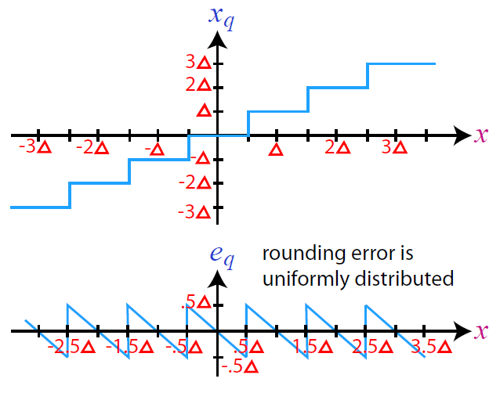
Uniform Quantization

Slide 7
Quantization Error Statistics : Mean
Probability density function of $e_{q}$:
$$p\left(e\right)=\left\{\begin{aligned}\frac{1}{△} \left|e\right|≤\frac{△}{2} \\ 0 otherwise\end{aligned}\right.$$
Mean of $e_{q}$:
$$E\left\{e_{q}\right\}≡\int_{−∞}^{∞}{e p\left(e\right)de=\int_{− \frac{△}{2}}^{\frac{△}{2}}{e\frac{1}{△}de}}$$
$$=\frac{1}{△}\int_{− \frac{△}{2}}^{\frac{△}{2}}{e de}=\frac{1}{△}{\left.\frac{e^{2}}{2}\right|}_{−\frac{△}{2}}^{\frac{△}{2}}=\frac{1}{△}\left[\frac{{(\frac{△}{2})}^{2}−{(−\frac{△}{2})}^{2}}{2}\right]=0$$

Slide 8
Quantization Error Statistics : Variance
Variance of $e_{q}$:
$$E\left\{{\left(e−E\left\{e_{q}\right\}\right)}^{2}\right\}≡\int_{−∞}^{∞}{{\left(e−E\left\{e_{q}\right\}\right)}^{2}p\left(e\right)de}$$
$$=\int_{− \frac{△}{2}}^{\frac{△}{2}}{{\left(e−E\left\{e_{q}\right\}\right)}^{2}\frac{1}{△}de}=\frac{1}{△}\int_{− \frac{△}{2}}^{\frac{△}{2}}{e^{2}de}$$
$$=0$$
$$=\frac{1}{△}{\left.\frac{e^{3}}{2}\right|}_{−\frac{△}{2}}^{\frac{△}{2}}=\frac{1}{△}\left[\frac{{\frac{△}{8}}^{3}−{(−\frac{△}{8})}^{3}}{3}\right]=\frac{△^{2}}{12}$$

Slide 9
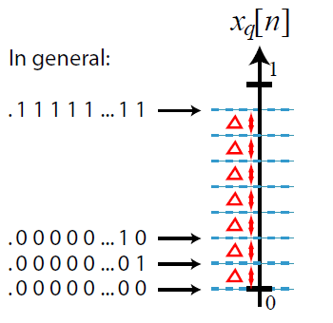
b-bit Representation
Assume the following normalization: 0 ≤ x[n] < 1.
b-bit unsigned fixed point fractional representation:
$$. x x x x x x x x . . . x$$
b-bits after the binary point

Slide 10
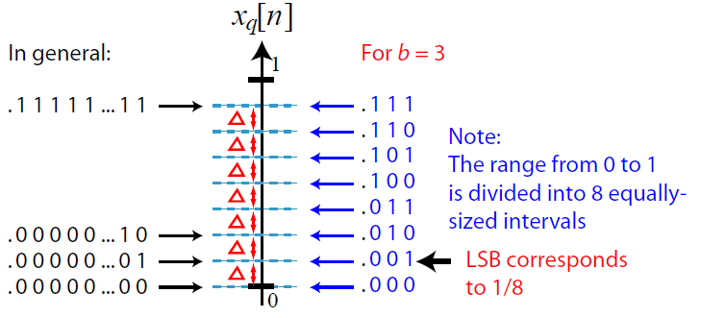
b-bit Representation
Assume the following normalization: 0 ≤ x[n] < 1.
b-bit unsigned fixed point fractional representation:
$$. x x x x x x x x . . . x$$
b-bits after the binary point

Slide 11
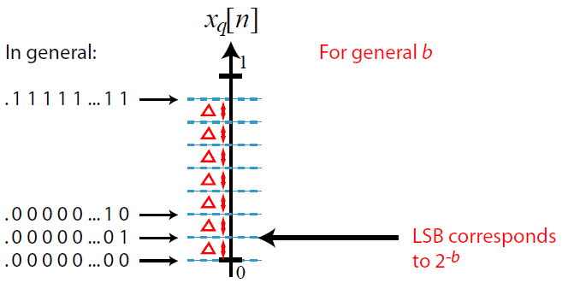
b-bit Representation
Assume the following normalization: 0 ≤ x[n] < 1.
b-bit unsigned fixed point fractional representation:
$$. x x x x x x x x . . . x$$
b-bits after the binary point

Slide 12
Error Statistics for b-bit Representation
Mean: For all sample time instants n:
$$E\left\{e_{q}\right\}=0$$
Variance: For all sample time instants n:
$$E\left\{{\left(e−E\left\{e_{q}\right\}\right)}^{2}\right\}=\frac{∆^{2}}{12}=\frac{{\left(2^{−b}\right)}^{2}}{12}=\frac{2^{−2b}}{12}$$

Slide 13
Error Statistics for b-bit Representation
Autocorrelation: For m≠0
$$R_{e_{q}}\left(m\right)=E\left\{\left(e_{q}\left(n\right)−E\left\{e_{q}\left(n\right)\right\}\right)\left(e_{q}\left(n+m\right)−E\left\{e_{q}\left(n+m\right)\right\}\right)\right\}$$
$$=0$$
$$=0$$
$=E\left\{e_{q}\left(n\right)e_{q}\left(n+m\right)\right\}$=$E\left\{e_{q}\left(n\right)\right\}E\left\{e_{q}\left(n+m\right)\right\}=0.0=0$
For m=0
$$R_{e_{q}}\left(0\right)=variance=E\left\{e_{q}\left(n\right)e_{q}\left(n+0\right)\right\}=E\left\{e_{q}^{2}(n)\right\}$$
$$=\frac{∆^{2}}{12}=\frac{2^{−2b}}{12}$$
Therefore
$$R_{e_{q}}\left(m\right)=\left\{\begin{aligned}\frac{∆^{2}}{12}=\frac{2^{−2b}}{12} m=0 \\ 0 m≠0\end{aligned}\right. =\frac{∆^{2}}{12}δ\left(m\right)=\frac{2^{−2b}}{12}δ\left(m\right)$$

Slide 14
Output Quantization
Q: How does an LTI filter affect uniform quantization noise of the input signal?
A: Need to investigate the associated output quantization noise statistics (mean, variance).

Slide 15
Output Quantization

Slide 16
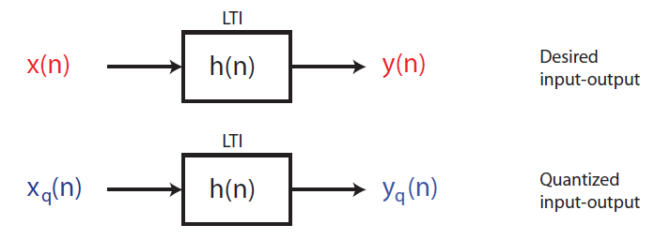
Output Quantization

Slide 17
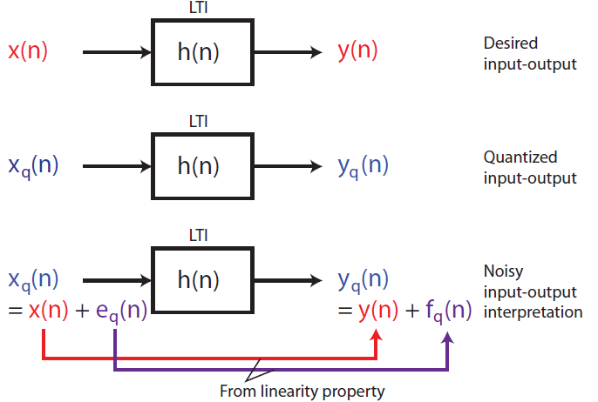
Output Quantization

Slide 18
Output Quantization Noise Statistics
where $f_{q}\left(n\right)=e_{q}\left(n\right)∗h(n)$
M$ean of f_{q}\left(n\right):$
$$E\left\{f_{q}\left(n\right)\right\}=E\left\{e_{q}\left(n\right)∗h(n) \right\}=E\left\{\sum_{k=−∞}^{∞}{e_{q}\left(k\right)h(n−k)}\right\}$$
$$=\sum_{k=−∞}^{∞}{E\left\{e_{q}\left(k\right)\right\}h\left(n−k\right)=0}$$
$$=0$$

Slide 19
Output Quantization Noise Statistics
Variance$of f_{q}\left(n\right):$
$$E\left\{{\left(f_{q}\left(n\right)−E\left\{f_{q}\left(n\right)\right\}\right)}^{2}\right\}$$
$$=0$$
$$=E\left\{{\left(f_{q}\left(n\right)\right)}^{2}\right\}=E\left\{{\left(\sum_{k=−∞}^{∞}{e_{q}\left(k\right)h(n−k)}\right)}^{2}\right\}$$
$$=E\left\{\sum_{k=−∞}^{∞}{e_{q}\left(k\right)h(n−k)}\sum_{l=−∞}^{∞}{e_{q}\left(l\right)h(n−l)}\right\}$$
$$=E\left\{\sum_{k=−∞}^{∞}{{\sum_{l=−∞}^{∞}{e_{q}\left(k\right)}e}_{q}\left(l\right)h(n−k)h(n−l)}\right\}$$

Slide 20
Output Quantization Noise Statistics
Variance$of f_{q}\left(n\right):$
$$=E\left\{\sum_{k=−∞}^{∞}{{\sum_{l=−∞}^{∞}{e_{q}\left(k\right)}e}_{q}\left(l\right)h(n−k)h(n−l)}\right\}$$
$$=\sum_{k=−∞}^{∞}{\sum_{l=−∞}^{∞}{E\left\{e_{q}\left(k\right)e_{q}\left(l\right)\right\}}h(n−k)h(n−l)}$$
$$=\sum_{k=−∞}^{∞}{\sum_{l=−∞}^{∞}{E\left\{e_{q}\left(k\right)e_{q}\left(l\right)\right\}}h(n−k)h(n−l)}$$
$$R_{e_{q}}(l−k)$$
$$=\sum_{k=−∞}^{∞}{\sum_{l=−∞}^{∞}{\frac{∆^{2}}{12}δ\left(l−k\right)}h(n−k)h(n−l)}$$

Slide 21
Output Quantization Noise Statistics
Variance$of f_{q}\left(n\right):$
$$=\sum_{k=−∞}^{∞}{\sum_{l=−∞}^{∞}{\frac{∆^{2}}{12}δ\left(l−k\right)}h(n−k)h(n−l)}$$
$$=\sum_{k=−∞}^{∞}{\sum_{l≠k}{\frac{∆^{2}}{12}δ\left(l−k\right)}h(n−k)h(n−l)}$$
$$+\sum_{k=−∞}^{∞}{\sum_{l=k}{\frac{∆^{2}}{12}δ\left(l−k\right)}h(n−k)h(n−l)}$$
$$=\sum_{k=−∞}^{∞}{\frac{∆^{2}}{12}1.h(n−k)h(n−k)}=\frac{∆^{2}}{12}\sum_{k=−∞}^{∞}{h^{2}(n−k) }$$

Slide 22
Output Quantization Noise Statistics
Variance$of f_{q}\left(n\right):$
$$=\frac{∆^{2}}{12}\sum_{k=−∞}^{∞}{h^{2}\left(n−k\right) let k^{′}=n−k}$$
$$=\frac{∆^{2}}{12}\sum_{k′=−∞}^{∞}{h^{2}\left(k′\right)}$$
$$=\frac{∆^{2}}{12}\sum_{n=−∞}^{∞}{h^{2}\left(n\right)=}\frac{∆^{2}}{24π}\int_{−π}^{π}{{\left|H(w)\right|}^{2}dw}$$
for h(n) real and using Parseval's relation:
$$\sum_{n=−∞}^{∞}{h^{2}\left(n\right)}\underset{↔}{ℱ}\frac{1}{2π}\int_{−π}^{π}{{\left|H(w)\right|}^{2}dw}$$

Slide 23
Output Quantization Noise Statistics
Finally for b-bit unsigned fixed point fractional representations ($△=2^{−b}$):
Mean
$$E\left\{f_{q}\left(n\right)\right\}=0$$
Variance
$$E\left\{{\left(f_{q}\left(n\right)−E\left\{f_{q}\left(n\right)\right\}\right)}^{2}\right\}=\frac{∆^{2}}{12}\sum_{n=−∞}^{∞}{h^{2}\left(n\right)=}\frac{2^{−2b}}{12}\sum_{n=−∞}^{∞}{h^{2}\left(n\right)}$$

